Slide 1
HW3 Result Presentation
Image Pyramid & Segmentation
CSE 5524, Prof: Jim Davis
Author: Yi Zhao (zhao.2175)

Slide 2
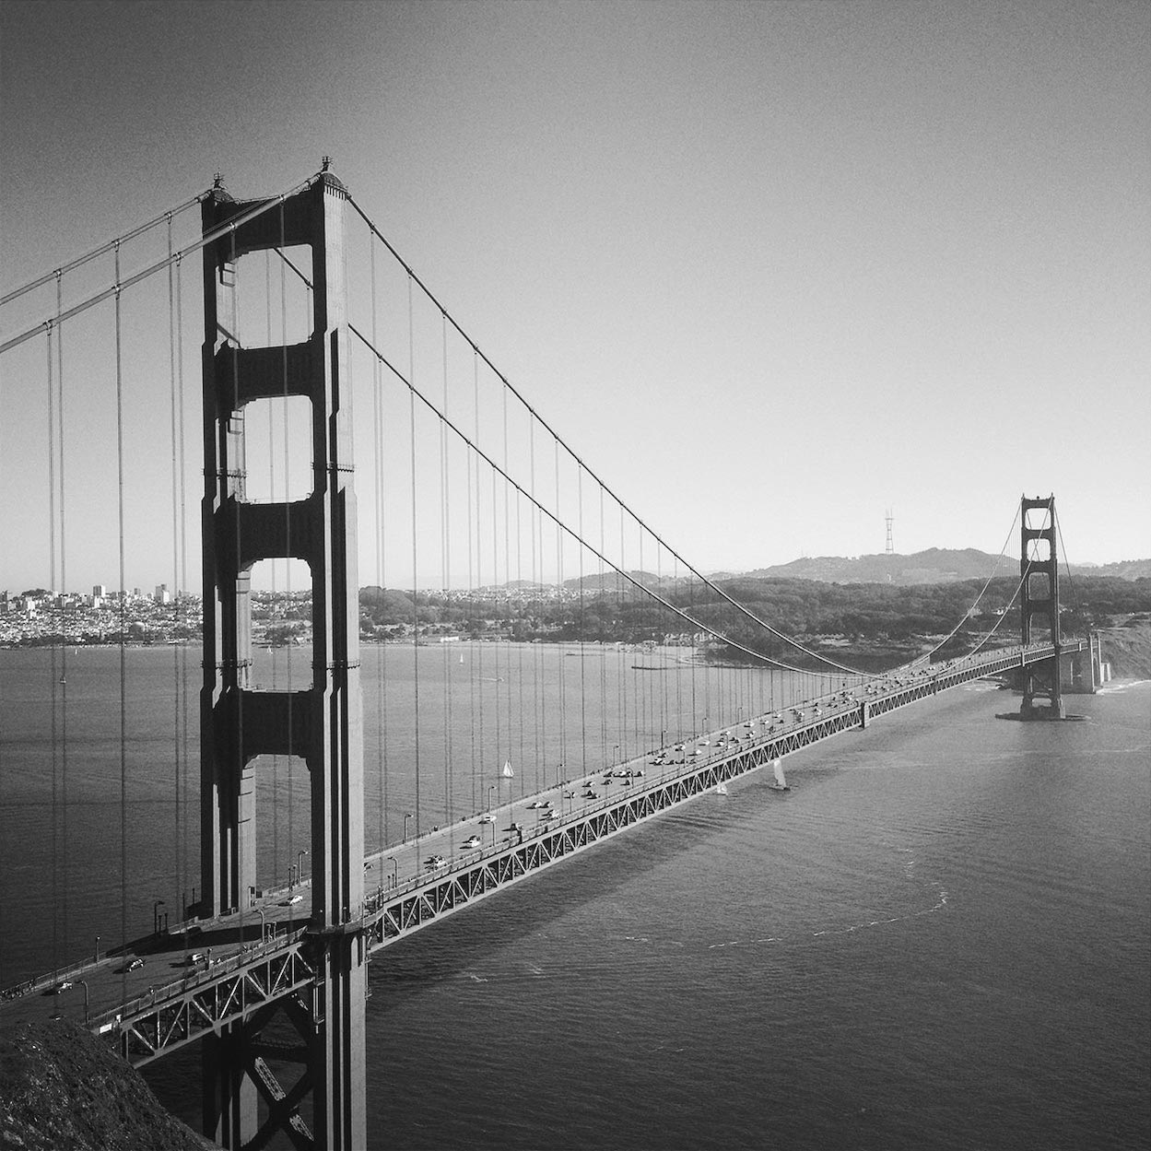



Gaussian Pyramids

Slide 3
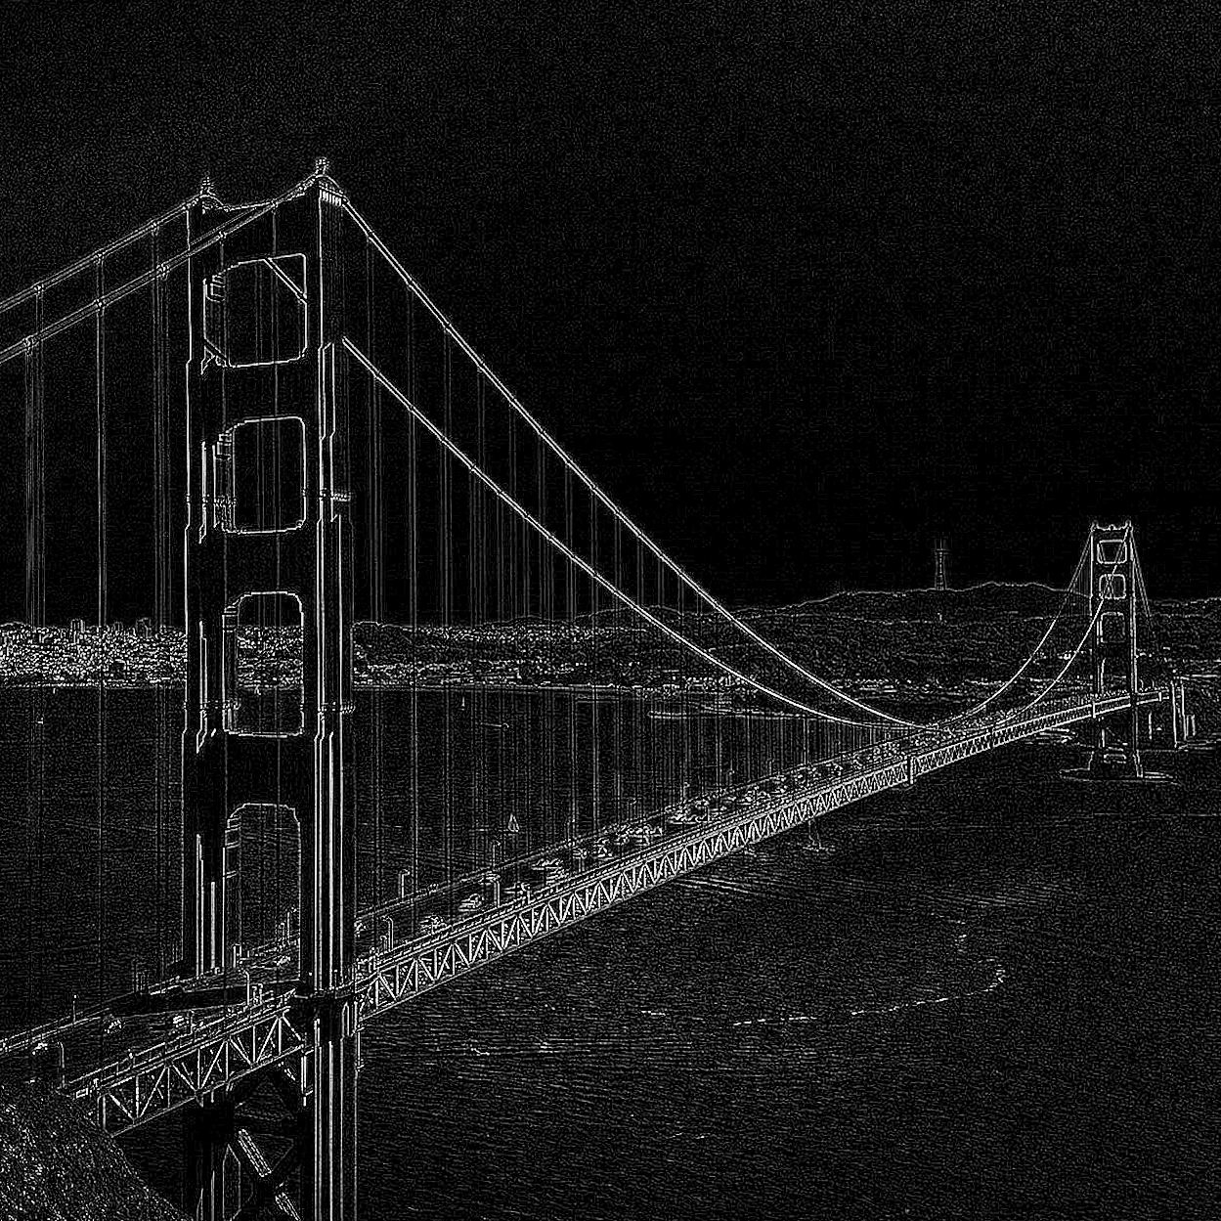
Laplacian (error) Pyramids

Slide 4
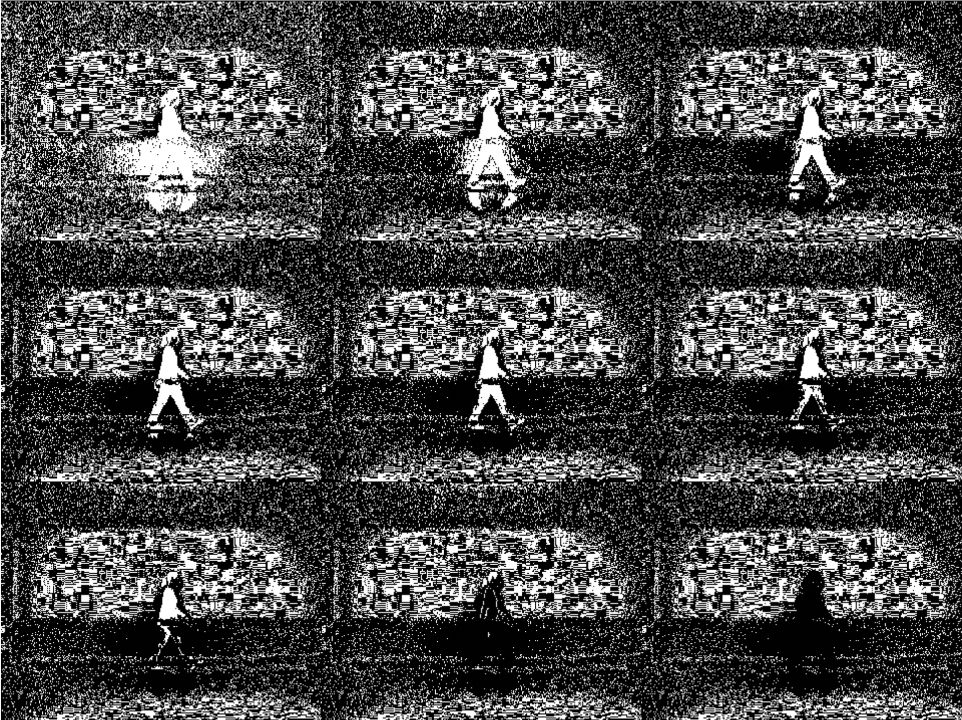
Background Subtraction I
T =
[10 20 35;
50 75 100;
150 200;255]

Slide 5
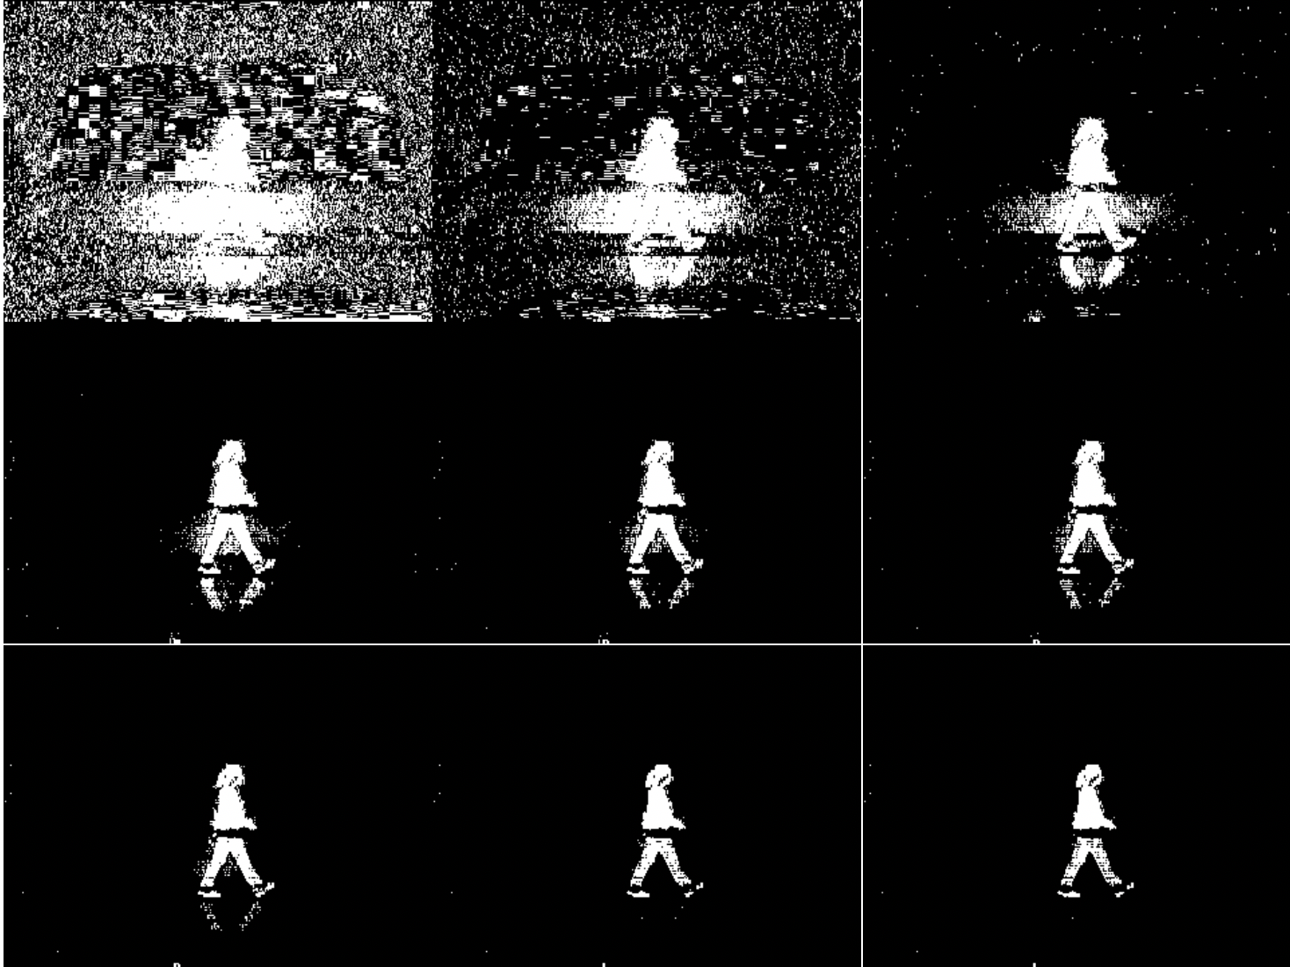
Background Subtraction II
T =
[1 3 5;
7 9 11;
14 17 20]

Slide 6


Dilation (left: origin with T=16)

Slide 7

Region Selection

